Slide 1
Webex General Instructions
If you have trouble with your PC audio, please mute the audio on your computer and use the call-in numbers below. If you have external PC speakers, you need to unplug them and use the internal PC speaker or headset.
Phone # 1-415-655-0001 access code: 126 767 4302
When you join the meeting you will be on MUTE. Find this icon and unmute yourself to speak but please MUTE yourself when you are done speaking for best sound quality for everyone.
There will be a survey in the chat box at the bottom right side of the screen, please take some time to look over and complete it.

Slide 2
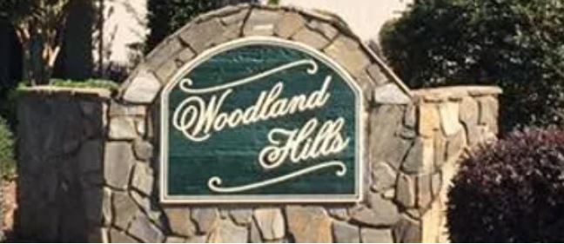
2021 Annual Meeting
Feb 9, 2021

Slide 3
Agenda
Review 2020 Expenses and Receipts
Changes 2020 and beyond
Review Approved 2021 big ticket items
Discuss stance/position on “voluntary” HOA
2021 Events
Board nominations and confirmations
Open Secretary and Treasurer Positions and confirmations
Other/Open discussion

Slide 4
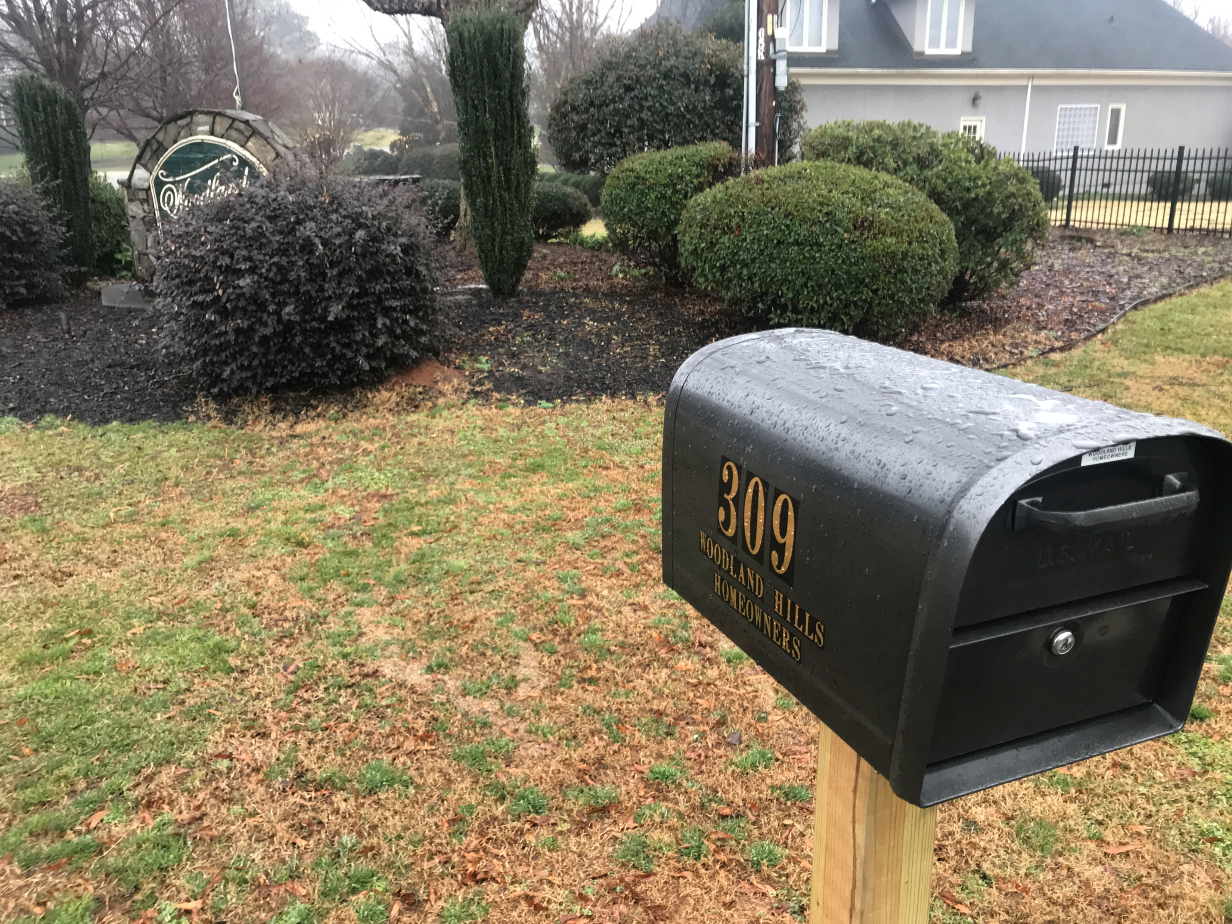
What’s New !
Online Invoicing
MOST residents received online invoice (Paypal)
Option to link/pay on website
Mailbox
Woodland Hills Property Owners of Iredell Co 309 Canvasback Drive
Mooresville, NC 28117
Physical address will now save us the PO box AND time to collect mail

Slide 5
What’s New !
Website Changes
Pay assessments and access lot keys online
Document resources (CCRs, By-Laws, Maps, Architecture request, etc…)
Community Event updates
Good Neighbor Guidelines
Online Concern Form
https://woodlandhillsnc.wixsite.com/welcome

Slide 6
2020 Expenditures and Receipts
Dues, Dock Keys, Initiations Fees: $2,365
Monument Utilities:$630
Dock/Access Lot Keys and Expenses: $396
Administrative Expenses: $450 (annual meeting, printing/invoicing, etc….)
Dock Repairs: $450
Other: $250 (Mailbox, mulch, etc…)
Carry over reserves : $200

Slide 7
Budget 2021
Opening Balance 2021: $12,700
Receipts 2021: $3,400
Expenses 2021: $6,850
YE Balance : $9,250
Dues, Dock Keys, Initiations Fees: $3,400
Multiple collection methods/points to maximize receipts
Monument Utilities, Mulch, Flag, Mailbox: $650
Electric, mulch, paint/stain, etc…..
Dock/Access Lot Keys and Expenses: $3,850
Paint, gravel, keys, hardware
Administrative Expenses: $2,150
Legal fees, Website Fees, PayPal fees, stamps, meeting expenses, etc…..
Community Enrichment: $200
Garage sale advertising, community wide block party, etc…..

Slide 8
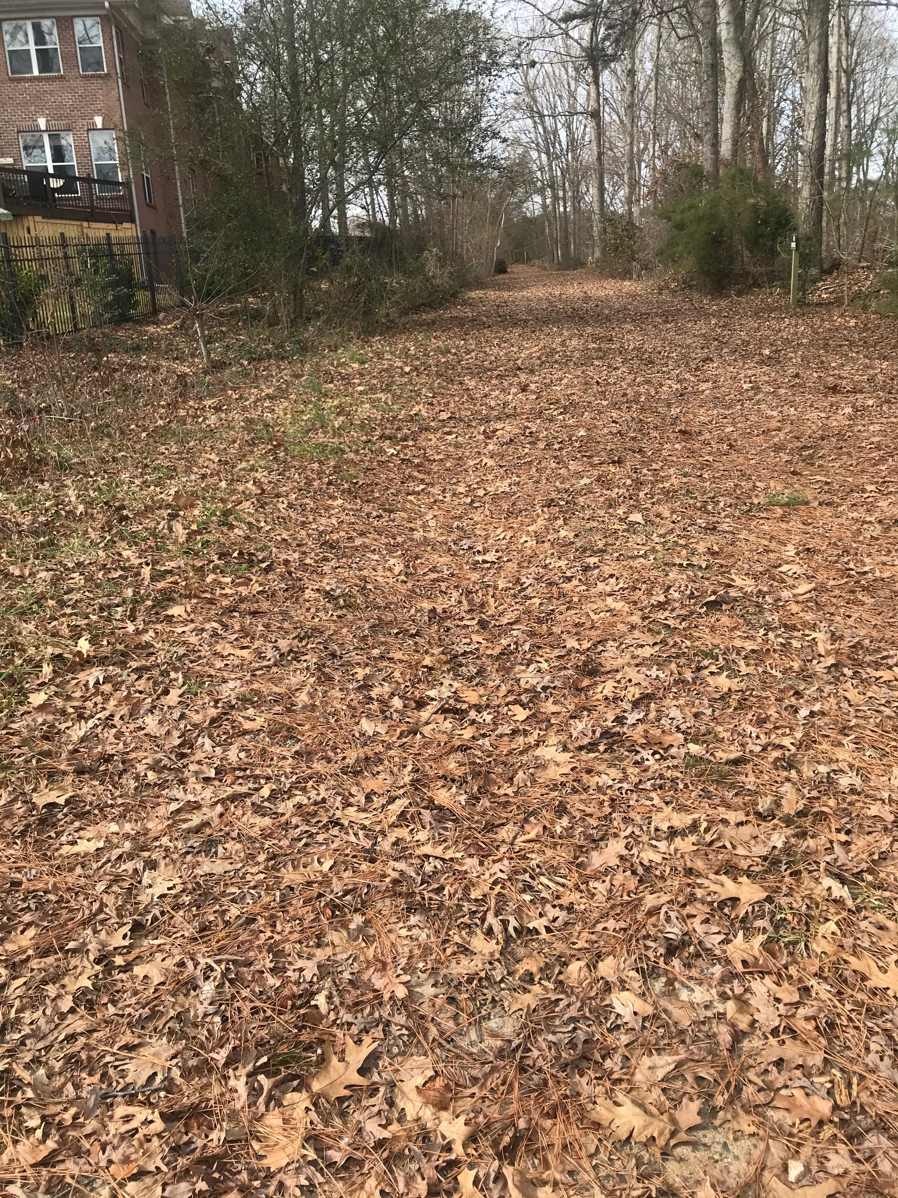
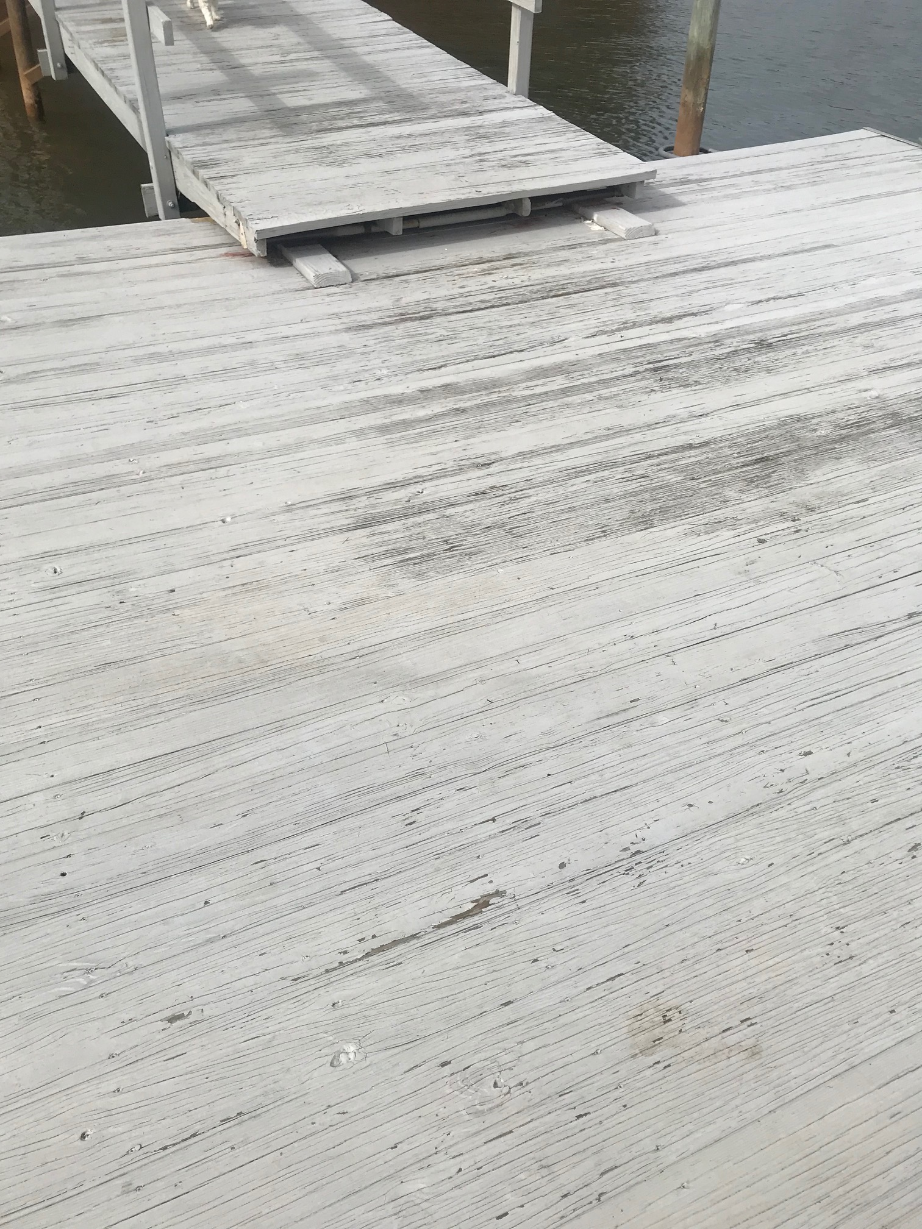
Expected “Big Ticket” expenses 2021
Access Lot Gravel: $2500
Crushed stone from access gate to launch ramp
Resolve ruts/mud, etc…
Greg Beck update
Dock repairs and hardware: $1250
Paint, deck board replacement
Hardware, bumpers, etc…

Slide 9
Expected “Big Ticket” expenses 2021
Legal Consultation: $1500
Inquiry and initiation of limiting non-owner-occupied short-term rentals
Possible consideration to unify CCR’s section 1-9 (Section 10 is Mandarin, not in our HOA)?
Summary of findings
No specific restrictions governing short-term rentals, aka “party houses”
WHPOA Covenants drafted for EACH section, some common, some uniquely different
Jeannine Tieri to update/ discussion

Slide 10
Is this HOA Voluntary?
Nay’s
Yay’s
Some CCR’s show “opt in,” others maybe mandatory
“I get no benefit from the dock”
“My realtor told me it was optional”
Some CCRs written before or after the $40,000 dock and ramp were installed?
Does your home value benefit from the access to LKN? See note from Lake Realty
Realtors verbal marketing of your home has no bearing on the CCRs you signed at closing.

Slide 11
Are the annual dues voluntary?
All property owners benefit from the Access Lot indirectly by overall increase in property value
All property owners benefit from a clean, well lit, well maintained Monument area by overall increased property value
All property owners benefit from the consistent architectural guidelines
All property owners are welcome to “be the change they want to see” by volunteering and participating in Association direction

Slide 12
What is the value of Lake Access?
According to Don Jennings, Lake Realty
“Certainly, lake access adds to the value of every home in the community, somewhere in the neighborhood of 1-3% is probably a reasonable number. The other important thing to consider, in the search engine of Carolina MLS, lake access is often a key criteria in folks looking to purchase. This became abundantly clear when 90% of the public access ramps were closed this past spring and summer due to COVID. Having that access is a very important marketing tool for all properties in the community.”

Slide 13
2021 Events
March 13, 2021-9:30a-11a- Access lot clean-up, Monument Clean-up
Bring your leaf blowers, pruning shears, hedge trimmers and pitch in to help clean up the access lot and monument area
Rain date March 20th
March 13, 2021- 9:30a-11a-Access lot gate key swap
Gate lock will be changed on this date
Surrender old key at this event
Rain date March 20th
August 28, 2021- Community Garage Sale
Details to follow (check the website)

Slide 14
2021 Call for volunteers
At-Large Board members
~ 5-7 hrs a year commitment
2-3 meetings/year
Review community business, architecture requests, budget and executive board oversight, committee leadership, etc…
Current At-Large Members
Tyler Roach, Canvasback
Todd Carey, Canvasback
Amber Silverthorn, Canvasback
Greg Beck, Broadbill
Open, TBD
Open, TBD

Slide 15
2021 Call for volunteers
Executive Board members
~ 10-12 hrs a year commitment
3-4 meetings/year (mostly phone/webex)
Communications and business of the community with Realtors, Title Agents, Banks, County, Utilities, Vendors, Property Owners, etc….
Current Members
President Matt Telecky, Broadbill (incumbent)
Secretary Jon Tieri, Canvasback (Open)
Treasurer Jeannine Tieri, Canvasback (Open)

Slide 16
Exec Board Member Responsibilities
Secretary (Open)
Resident Communications
Monitor Email, Collect Mail and distribute
Assist in Website maintenance
Maintain/organize GoogleDrive
Board meeting minutes and records
Access Lot Key distribution and management
Treasurer (Open)
Maintain expenses and receipts ledger (GoogleDrive)
Maintain Paypal account, bank account, (99% online banking)
Review solicited contractor bids
Pay utilities (online) and expenses within guidance of budget
Prepare invoices and deposit resident assessments
Assist President in annual budget process

Slide 17
Open Discussion

